Slide 1
Electronic Devices
Final Term Lecture - 03
Reference book:
Electronic Devices and Circuit Theory (Chapter-6)
Robert L. Boylestad and L. Nashelsky , (11th Edition)

Slide 2
OBJECTIVES
Become familiar with the construction and operating characteristics of Junction Field Effect (JFET), Metal-Oxide Semiconductor FET (MOSFET), and Metal-Semiconductor FET (MESFET) transistors.
Be able to sketch the transfer characteristics from the drain characteristics of a JFET, MOSFET, and MESFET transistor.
Understand the vast amount of information provided on the specification sheet for each type of FET.
Be aware of the differences between the dc analysis of the various types of FETs.

Slide 3
FETs vs BJTs
FET’s (Field – Effect Transistors) are much like BJT’s (Bipolar Junction Transistors).
Similarities:
Amplifiers
Switching devices
Impedance matching circuits
Differences:
FET’s are voltage controlled devices whereas BJT’s are current controlled devices.
FET’s are unipolar devices whereas BJT’s are bipolar devices.
FET’s also have a higher input impedance, but BJT’s have higher gains.
FET’s are less sensitive to temperature variations and because of their construction they are more easily integrated into IC’s.

Slide 4
FET TYPES
JFET: Junction Field-Effect Transistor
MOSFET: Metal-Oxide Semiconductor Field-Effect Transistor
D-MOSFET ~ Depletion type MOSFET
E-MOSFET ~ Enhancement type MOSFET

Slide 5
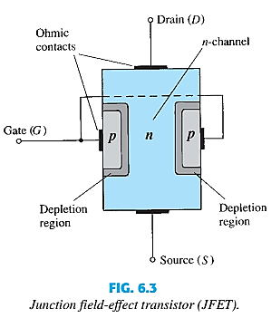
JFET CONSTRUCTION
There are two types of JFETs
n- channel
p- channel
The n-channel is more widely used.
There are three terminals:
Drain (D) and Source (S) are connected to n-channel
Gate (G) is connected to the p-type material
Check this: http://www-g.eng.cam.ac.uk/mmg/teaching/linearcircuits/jfet.html

Slide 6
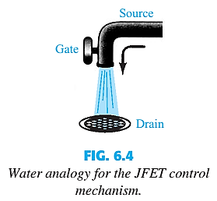

BASIC OPERATION OF JFET
JFET operation can be compared to a water spigot.
The source of water pressure is the accumulation of electrons at the negative pole of the drain-source voltage.
The drain of the water is the electron deficiency (or holes) at the positive pole of the applied voltage.
The control of flow of water is the gate voltage that controls the width of the n channel and therefore, the flow of charges from source to drain.

Slide 7
JFET OPERATING CHARACTERISTICS
There are three basic operating conditions for a JFET:
A. V_{GS} = 0, V_{DS} increasing to some positive value
B. V_{GS} < 0, V_{DS} at some positive value
C. Voltage-Controlled Resistor

Slide 8
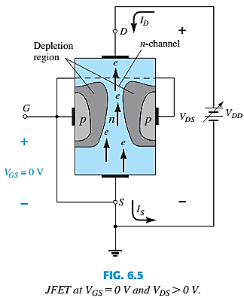
JFET OPERATING CHARACTERISTICS: V_{GS} = 0 V
Three things happen when V_{GS} = 0 and V_{DS} is increased from 0 to a more positive voltage:
The depletion region between p-gate and n-channel increases as electrons from n-channel combine with holes from p-gate.
Increasing the depletion region, decreases the size of the n-channel which increases the resistance of the n-channel.
But even though the n-channel resistance is increasing, the current (I_{D}) from Source to Drain through the n-channel is increasing. This is because V_{DS} is increasing.

Slide 9
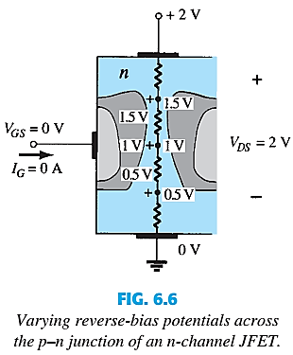
JFET OPERATING CHARACTERISTICS: V_{GS} = 0 V
It is important to note that the depletion region is wider near the top of both p-type Materials.
Assuming a uniform resistance in the n-channel, the resistance of the channel can be broken down to the divisions appearing in Figure.
The current I_{D} will establish the voltage levels through the channel as indicated on the same figure. The result is that the upper region of the p-type material will be reverse biased by about 1.5 V, with the lower region only reverse-biased by 0.5 V.
The greater the applied reverse bias, the wider the depletion region—hence the distribution of the depletion region as shown in figure. The fact that the p-n junction is reverse-biased for the length of the channel results in a gate current of zero amperes.

Slide 10
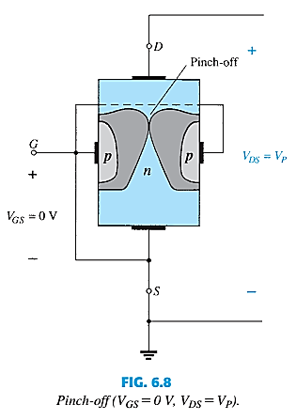
PINCH-OFF
If V_{GS} = 0 and V_{DS} is further increased to a more positive voltage, then the depletion zone gets so large that it pinches off the n-channel.
This suggests that the current in the n-channel (I_{D}) would drop to 0A, but it does just the opposite: as V_{DS} increases, so does I_{D}.

Slide 11
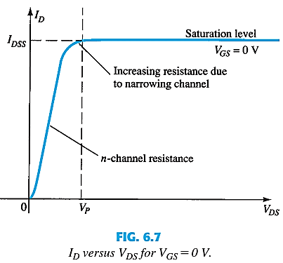
SATURATION
At the pinch-off point:
Any further increase in V_{DS} does not produce any increase in I_{D}. V_{DS} at pinch-off is denoted as V_{p}.
I_{D} is at saturation or maximum. It is referred to as I_{DSS}.
The ohmic value of the channel is at maximum.

Slide 12
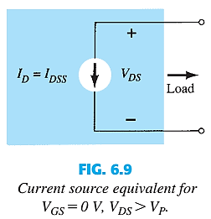
JFET modeling when I_{D}=I_{DSS}, V_{GS}=0, V_{DS}>V_{P}
I_{DSS} is the maximum drain current for a JFET and is defined by the conditions
V_{GS} = 0 V and V_{DS} > V_{P}.

Slide 13
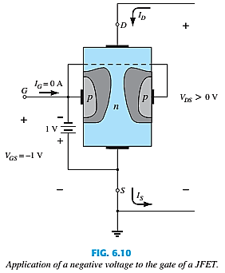
V_{GS} < 0, V_{DS} AT SOME POSITIVE VALUE
As V_{GS} becomes more negative the depletion region increases.

Slide 14
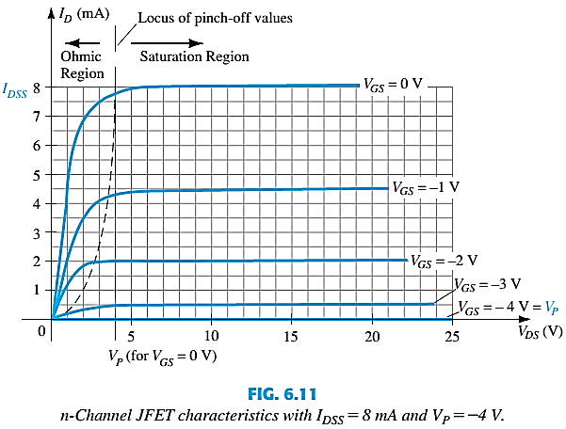
I_{D} < I_{DSS}
As V_{GS} becomes more negative:
The JFET will pinch-off at a lower value of V_{DS}.
I_{D} decreases (I_{D} < I_{DSS}) even though V_{DS} is increased.
Eventually I_{D} will reach 0A. V_{GS} at this point is called V_{p} or V_{GS(off).}
Also note that at high levels of V_{DS} the JFET reaches a breakdown situation. I_{D} will increases uncontrollably if V_{DS} > V_{DSmax}.

Slide 15
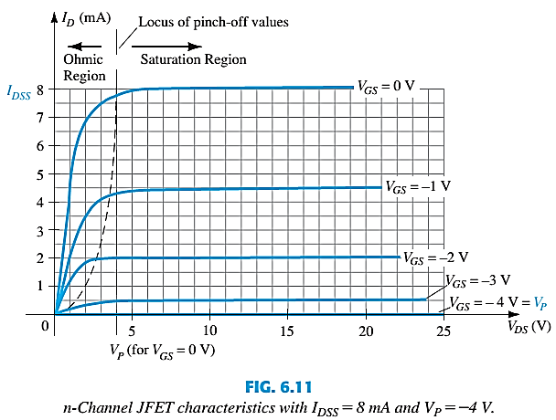

JFET OPERATING CHARACTERISTICS: VOLTAGE CONTROLLED RESISTOR
The region to the left of the pinch-off point is called the ohmic region.
The JFET can be used as a variable resistor, where V_{GS} controls the drain-source resistance (r_{d}).
The slope of each curve and therefore the resistance of the device between drain and source for V_{DS} < V_{P} is a function of the applied voltage V_{GS.}
As V_{GS} becomes more negative, the resistance (r_{d}) increases.

Slide 16
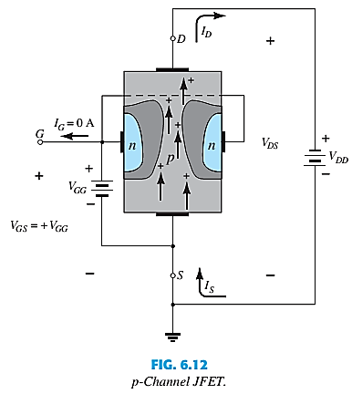
P-CHANNEL JFETS
p-Channel JFET acts the same as the n-channel JFET, except the polarities and currents are reversed.

Slide 17
End of Lecture-3

